Slide 1

RV COLLEGE OF ENGINEERING
IDEA LAB EL
An Automated Plant Watering System
with Arduino UNO

Slide 2
MEMBERS (CH-A)
ARYAN LODHA
VEDANT SUD
NEHAL KARJAGI
RVCE24BCH043
RVCE24BCH004
RVCE24BCH008

Slide 3
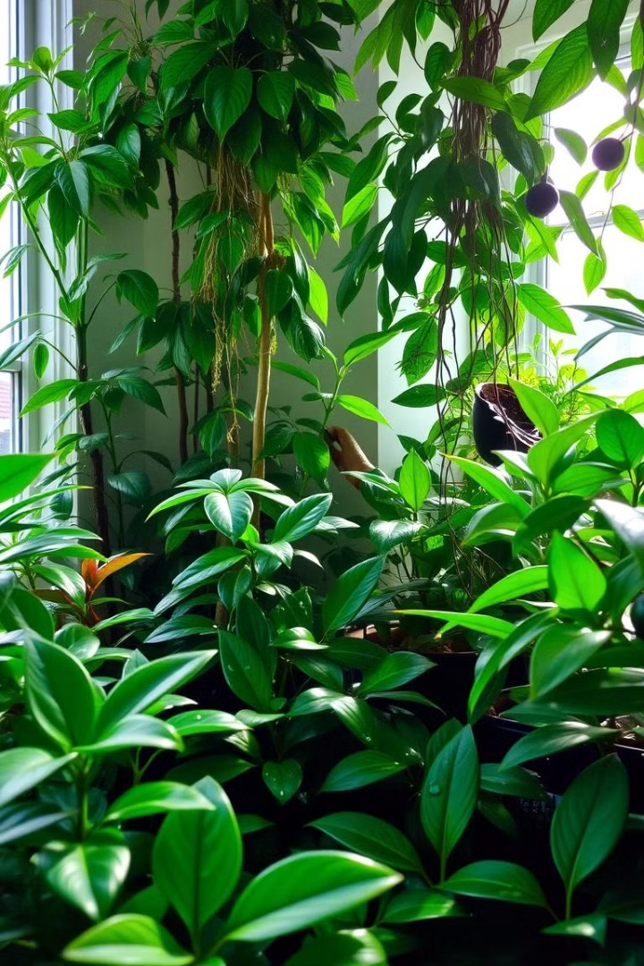
Smart Plant Watering System
This system utilizes an Arduino Uno microcontroller, a soil moisture sensor, a relay module, a water pump, and a power source. By monitoring soil moisture levels, it automatically waters plants as needed, reducing water waste and promoting healthier plant growth.

Slide 4
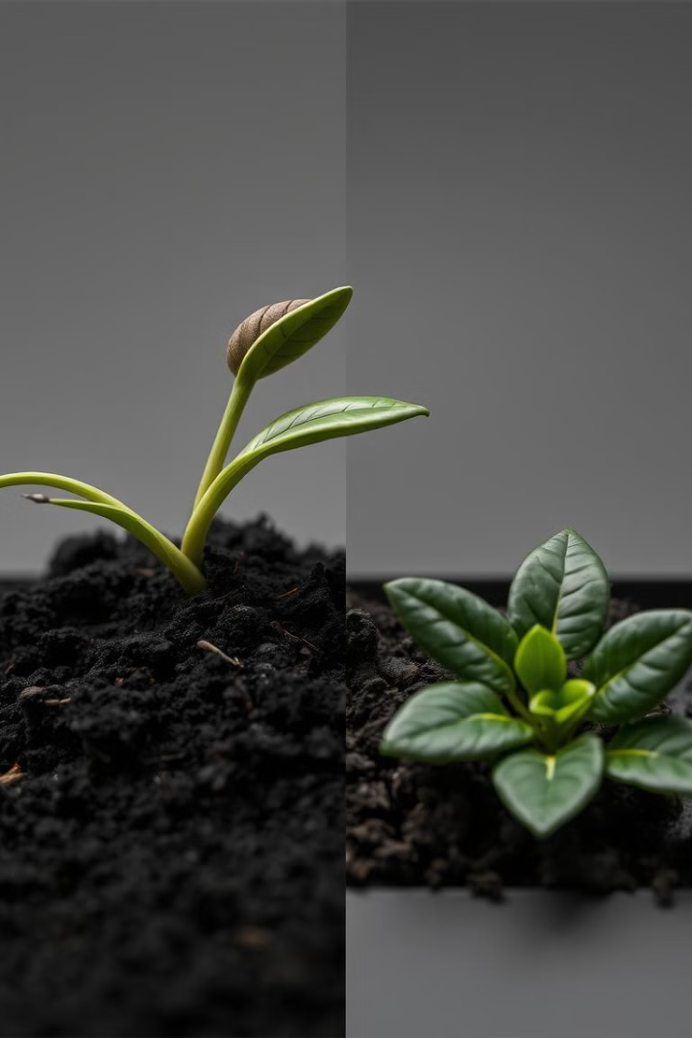
Problem Statements
Inconsistent Watering
Time Constraints
Plants often receive either too little or too much water, leading to wilting or root rot.
Busy schedules and travel make consistent plant care challenging, leading to neglected plants.
Water Waste
Overwatering is wasteful and can contribute to environmental problems.

Slide 5
Components
Arduino Uno – 1
Soil Moisture Sensor – 1
Water Pump (small DC) – 1
Relay Module (5V) – 1
12V Power Supply – For the pump
Jumper Wires – Multiple
Breadboard – 1
LCD – To indicate water pumping

Slide 6
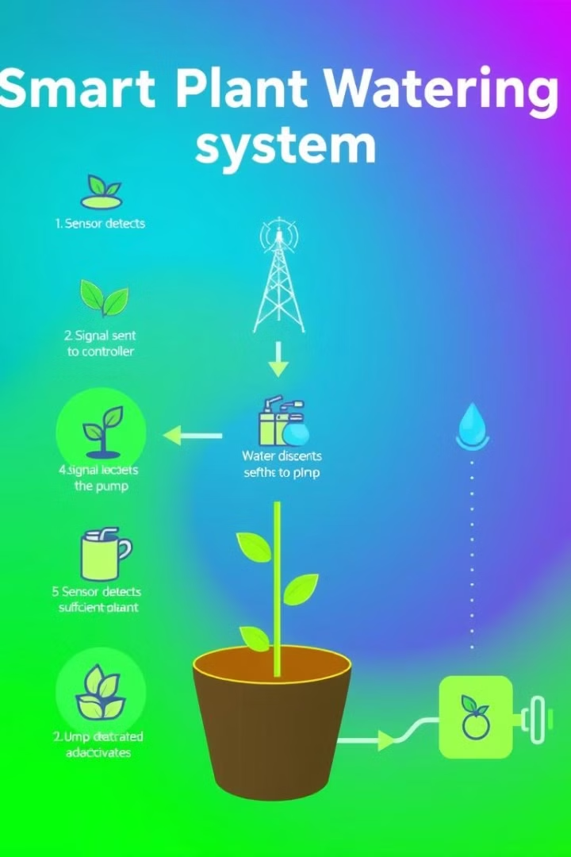
How the System Works
1
Soil Moisture Sensor
Reads soil moisture level as an analog signal. A low reading indicates dry soil, while a high reading indicates moist soil.
2
Relay Module
Acts as a switch to control the water pump. The Arduino activates the relay to power the pump.
3
Pump Activation
If the soil is dry, the pump turns on for 5 seconds to water the plant.
4
LCD Indicator
The LCD will be displayed when the pump is running, providing visual confirmation.

Slide 7




Steps to Build the System
Circuit Connections
Code Development
Testing and Calibration
Connect the soil moisture sensor, relay module, and water pump to the Arduino Uno according to the circuit diagram.
Write and upload the Arduino code, which controls the system based on the sensor readings and activates the pump accordingly.
Test the system with a plant and calibrate the moisture threshold for optimal watering. Adjust the code if needed to ensure proper operation.

Slide 8
Assembling of the system
Mount the soil moisture sensor into the soil.
Place the pump in a water container with a tube leading to the plant pot.
Double-check connections for safety, especially with the relay and pump.

Slide 9
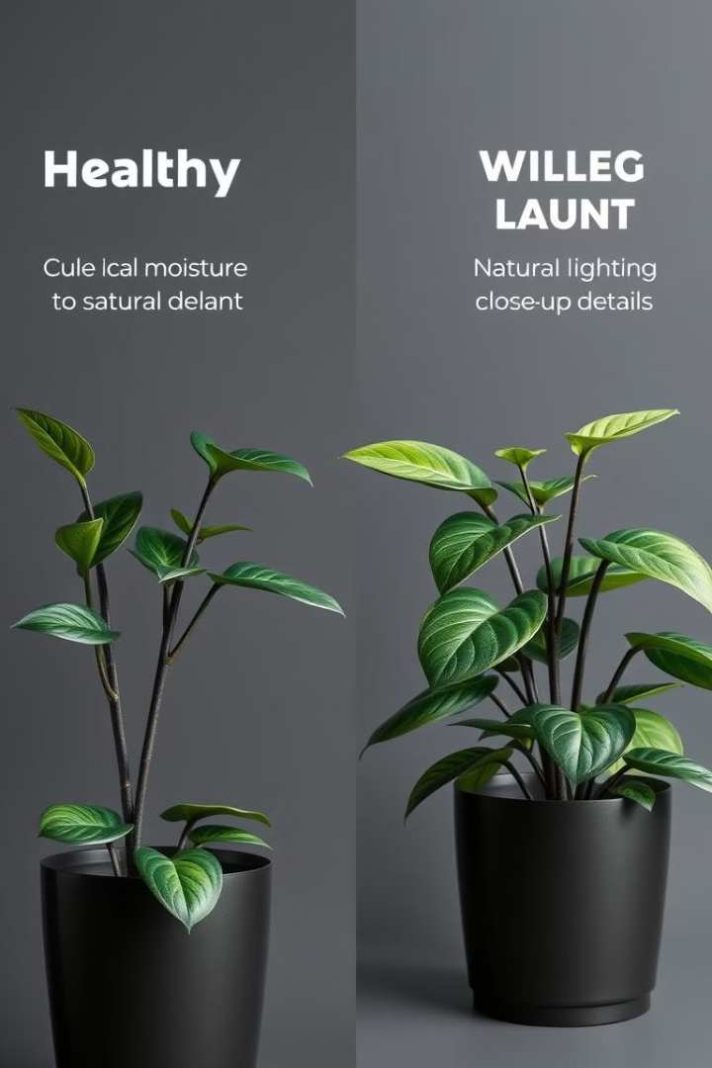



Benefits of Automated Watering
Improved Plant Health
Reduced Water Waste
Consistent moisture reduces wilting and promotes healthy plant growth.
Waters only when necessary, minimizing water usage and waste.
Convenience
Frees up time and effort, making plant care easier and more manageable.

Slide 10
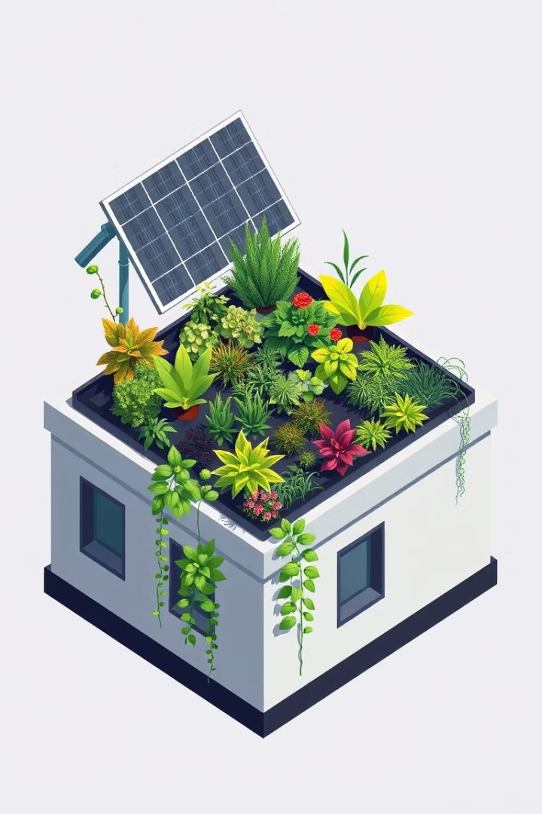
Practical Applications
1
Small Home Gardens
2
Urban Farming
Automate irrigation for vertical or hydroponic farming.
Maintain potted plants or balcony gardens.
3
Remote Locations
Ideal for gardens where regular human intervention is challenging.

Slide 11

Conclusions
This smart plant watering system offers a convenient and efficient solution for plant care, ensuring healthy growth and reducing water waste. By utilizing renewable energy sources like solar panels, the system can operate independently, reducing its carbon footprint and making it a sustainable solution. This project demonstrates that practical solutions for automated irrigation can be built using affordable and readily available components, making it accessible and impactful.

Slide 12


